Slide 1

Applied Data Science Capstone

Slide 2
EXECUTIVE SUMMARY
The capstone project aims to predict the landing outcome of SpaceX's Falcon 9 first stage with various machine learning classifiers.
The project's core activities are:
Gathering, refining, and structuring data
Initial data examination
Creating dynamic visualizations of data
Prediction through machine learning
Our analysis indicates a link between certain launch characteristics and the final result, whether a launch succeeds or fails. We've also deduced that a decision tree could be the optimal predictive model for determining the success of the Falcon 9's first stage landing.

Slide 3
INTRODUCTION
In this capstone project, our objective is to forecast the successful landing of SpaceX's Falcon 9 first stage. While SpaceX lists a launch price of $62 million, competitors may charge over $165 million. The ability to reuse the first stage underpins SpaceX's cost advantage. By predicting landing outcomes, we can estimate launch costs, valuable intelligence for potential SpaceX competitors in bidding processes.
Although some Falcon 9 landings fail as part of planned disposals into the ocean, our analysis focuses on the correlation between launch attributes—such as payload mass, orbit type, and launch site—and the likelihood of a successful first-stage landing.

Slide 4
METHODOLOGY
Our capstone project methodology is structured as follows:
For data collection, cleaning, and preparation, we utilize the SpaceX API and methods of web scraping.
We conduct Exploratory Data Analysis (EDA) with the aid of libraries such as Pandas, NumPy, and tools like SQL for database interaction.
We employ Matplotlib, Seaborn, Folium, and Dash for the visualization of data to understand and present our findings visually.
Lastly, we apply machine learning algorithms for prediction purposes, including Logistic Regression, Support Vector Machine (SVM), Decision Tree, and K-Nearest Neighbors (KNN).

Slide 5
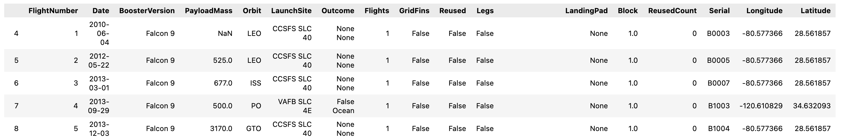
METHODOLOGY
1. Gathering, refining, and structuring data
In the first phase of our methodology, we concentrate on sourcing and refining data. We utilize the SpaceX API, available at https://api.spacexdata.com/v4/rockets/, to collect information on a range of SpaceX rocket launches, specifically narrowing down to Falcon 9 launches.
To ensure data quality, we address missing values by imputing the mean of the respective feature they are missing from. The dataset we compile consists of 90 instances, each described by 17 features. An example of the initial data can be seen in the subsequent illustration.

Slide 6
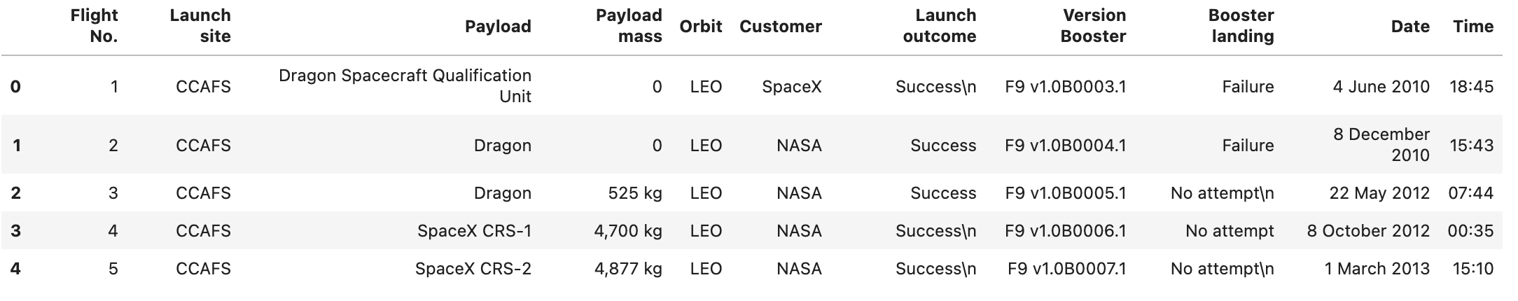
METHODOLOGY
1. Gathering, refining, and structuring data
Additionally, we employ web scraping to augment our dataset with Falcon 9 launch details from Wikipedia, specifically from the page "List of Falcon 9 and Falcon Heavy launches," archived at https://en.wikipedia.org/w/index.php?title=List_of_Falcon_9_and_Falcon_Heavy_launches&oldid=1027686922.
This source exclusively provides Falcon 9 launch data, from which we extracted a dataset comprising 121 records, each characterized by 11 attributes. A depiction of the initial dataset rows is provided in the following visual.

Slide 7
METHODOLOGY
1. Gathering, refining, and structuring data
Subsequent to the initial data collection, the dataset undergoes further processing to fill any missing values and encode categorical features using one-hot encoding technique. We also introduce an additional 'Class' column to the dataset, which assigns a '0' for a failed launch and a '1' for a successful one. This results in a refined dataset containing 90 instances and 83 features.

Slide 8



METHODOLOGY
2. Exploratory Data Analysis (EDA)
Within our exploratory data analysis, we leverage Pandas and NumPy to extract foundational insights from our data, including the frequency of launches per site, the distribution of orbits, and the success rates of missions.
For more in-depth queries, we use SQL to address questions regarding the dataset, such as identifying all unique launch sites, computing the total and average payload mass for specific missions like those under NASA's CRS program, and assessing payload variations across different versions of the Falcon 9 rocket, like the F9 v1.1.

Slide 9



METHODOLOGY
2. Exploratory Data Analysis (EDA)
For data visualization, we utilize Matplotlib and Seaborn to create scatterplots, bar charts, and line charts, which help us interpret the relationships between key features such as flight number versus launch site, payload mass versus launch site, and success rate versus orbit type.
Additionally, we employ Folium for interactive mapping to pinpoint all launch sites, differentiate between successful and unsuccessful launches at each site, and display the proximity of launch sites to nearby cities, railways, or highways.

Slide 10

METHODOLOGY
3. Creating dynamic visualizations of data
We use Dash to construct an interactive web application that enables users to manipulate the input through dropdown menus and a range slider. The application features a pie chart and a scatterplot that reveal the aggregate number of successful launches by launch site and explore the relationship between payload mass and mission outcomes, distinguishing between success and failure for each launch site.

Slide 11

METHODOLOGY
4. Prediction through machine learning
We utilize Scikit-learn's suite of tools to construct our machine learning models. Our predictive modeling process encompasses data normalization, partitioning the dataset into training and testing subsets, and formulating various machine learning algorithms such as Logistic Regression, Support Vector Machine (SVM), Decision Tree, and K-Nearest Neighbors (KNN).
We train these models, optimize their hyperparameters, and assess their performance using accuracy metrics and confusion matrices.

Slide 12
RESULTS
Our findings are organized into five distinct sections:
SQL (EDA with SQL)
Matplotlib and Seaborn (EDA with Visualization)
Folium
Dash
Predictive Analysis
For clarity in the visual representations throughout these sections, 'class 0' denotes a failed launch, whereas 'class 1' signifies a launch that was successful.

Slide 13
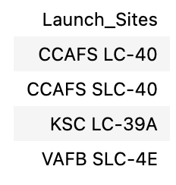
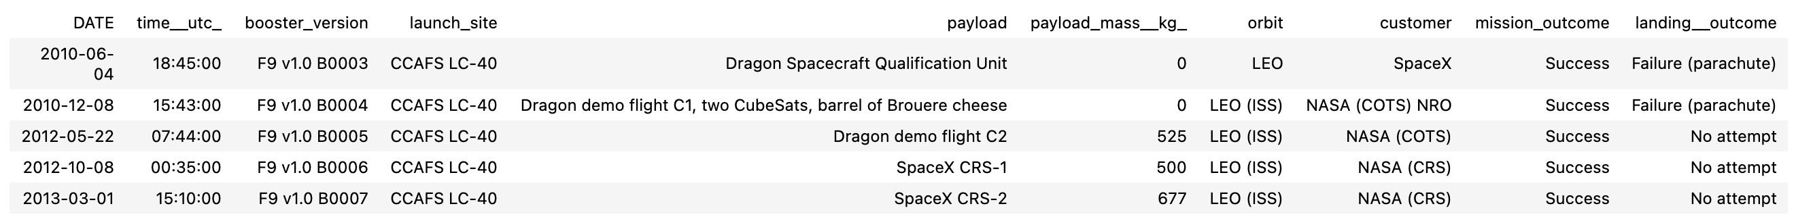
RESULTS
SQL (EDA with SQL)
The distinct launch sites utilized for the space missions are listed,
and we have identified five instances where the launch sites' designations commence with 'CCA'.

Slide 14
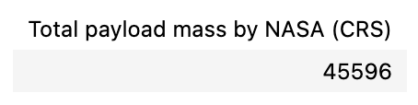
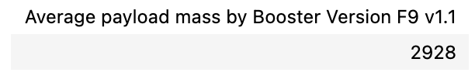
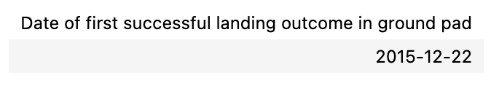
RESULTS
SQL (EDA with SQL)
Booster missions conducted by NASA under the CRS program have a cumulative payload mass of 45,596 kilograms.
The average mass of payloads carried by the Falcon 9 version 1.1 booster is 2,928 kilograms.
The first successful ground pad landing occurred on December 22, 2015.

Slide 15
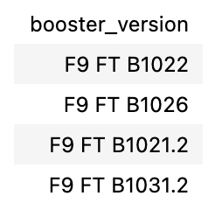
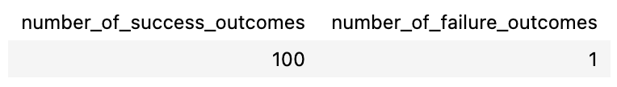
RESULTS
SQL (EDA with SQL)
Boosters that have successfully landed on a drone ship and carried a payload mass between 4000 and 6000 kilograms are listed.
The total count of mission outcomes includes 100 successes and 1 failure.

Slide 16
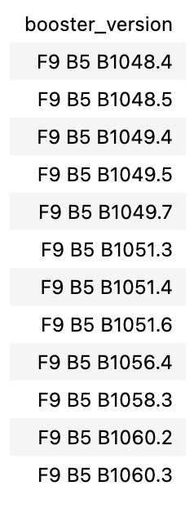
RESULTS
SQL (EDA with SQL)
Listed are the versions of Falcon 9 boosters that have transported the heaviest payloads.

Slide 17
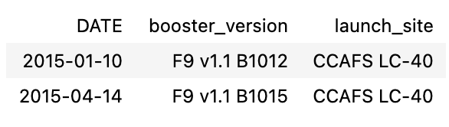
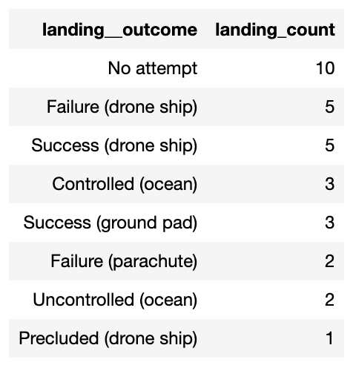
RESULTS
SQL (EDA with SQL)
In 2015, there were failed drone ship landing attempts associated with specific Falcon 9 booster versions and launch sites.
Additionally, a ranking of landing outcomes based on their frequency from 2010-06-04 to 2017-03-20 has been compiled, ordered from the most to the least occurrences.

Slide 18
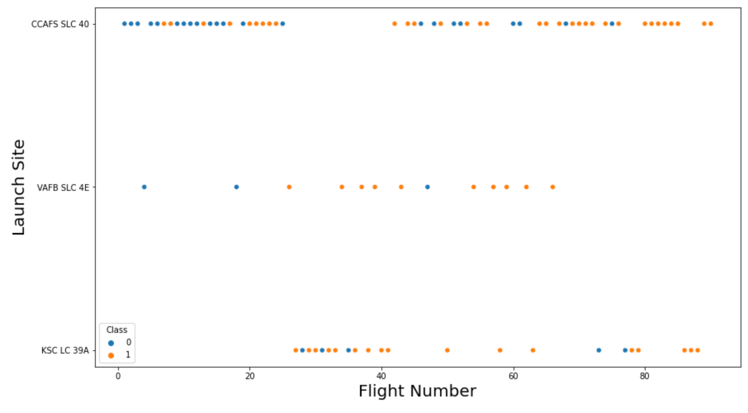
RESULTS
Matplotlib and Seaborn (EDA with Visualization)
The correlation between launch numbers and their respective launch sites.

Slide 19
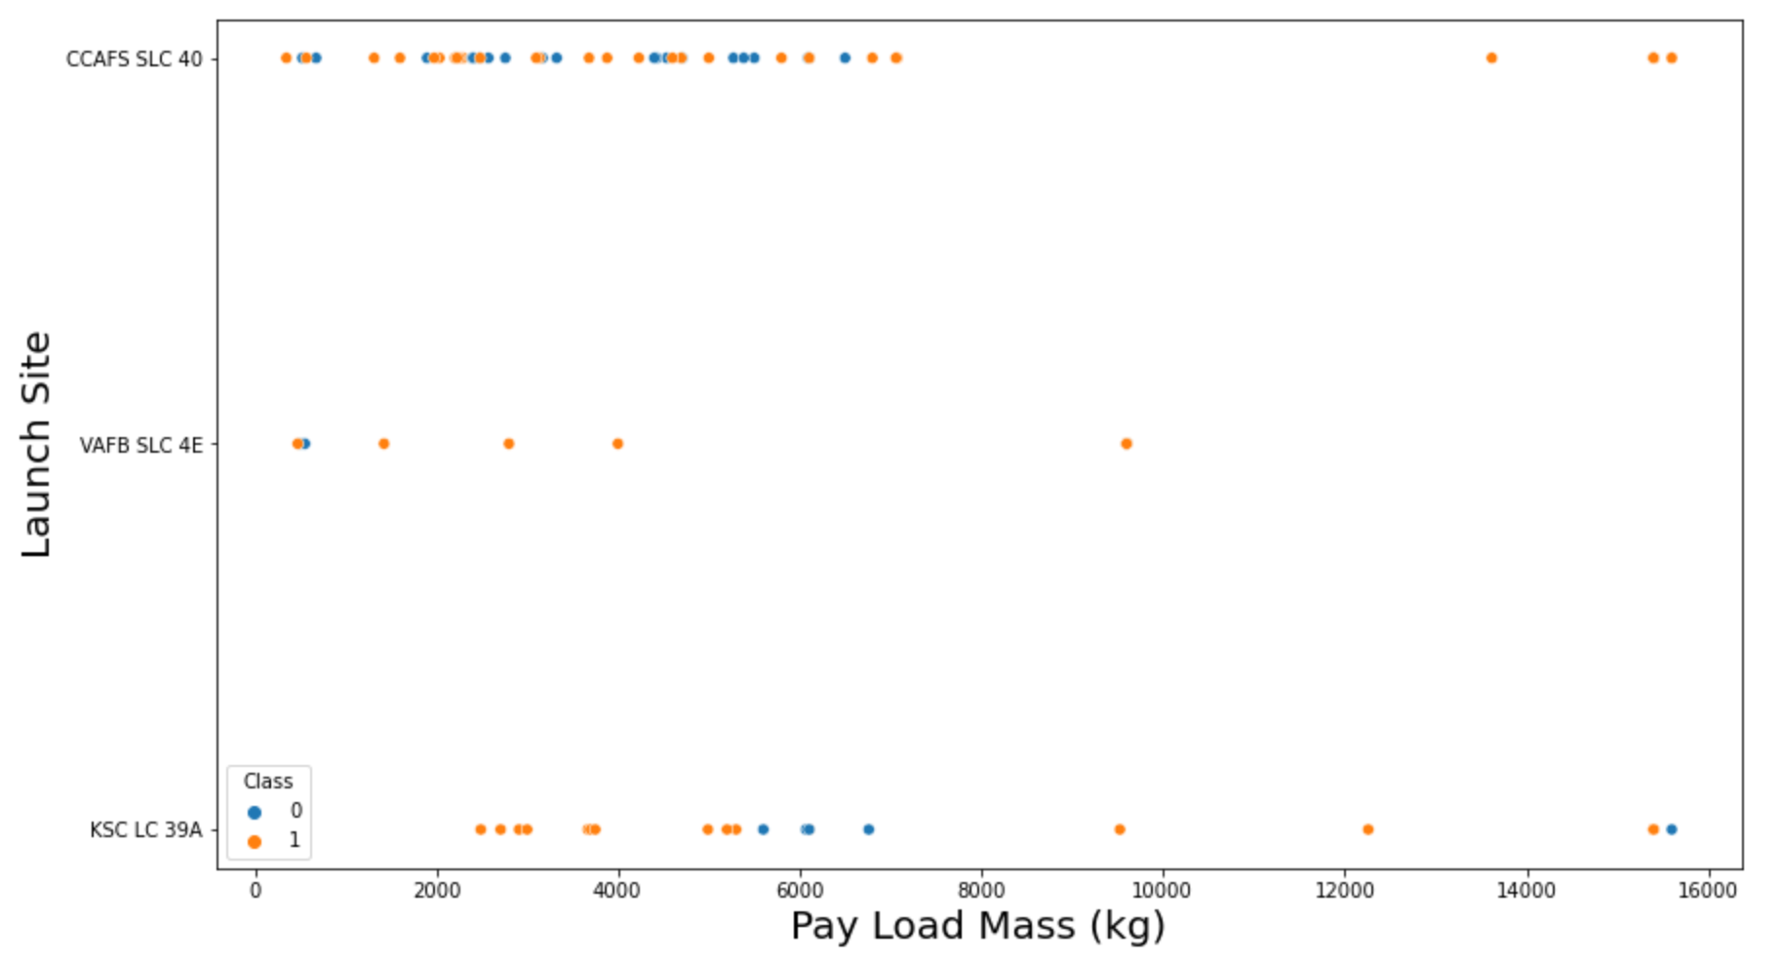
RESULTS
Matplotlib and Seaborn (EDA with Visualization)
The connection between the mass of payloads and the locations from which they are launched.

Slide 20
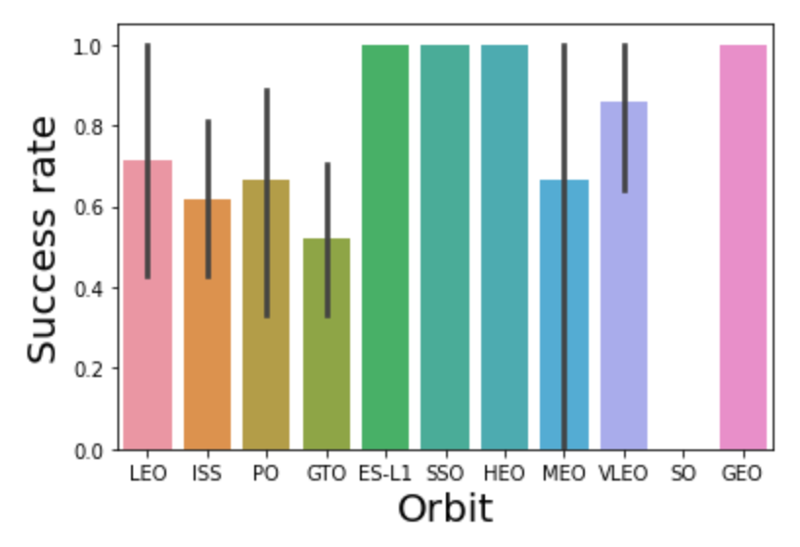
RESULTS
Matplotlib and Seaborn (EDA with Visualization)
The link between the success rates of launches and the types of orbits achieved.

Slide 21
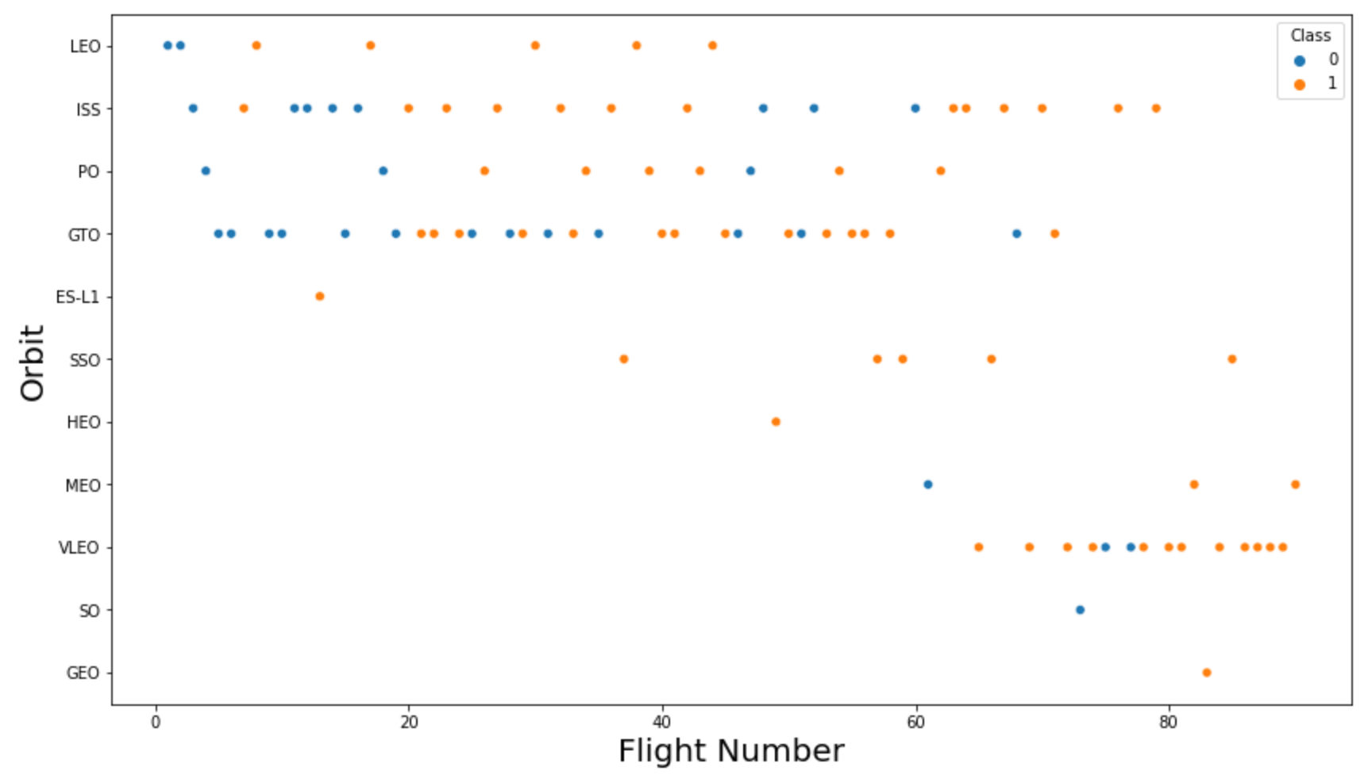
RESULTS
Matplotlib and Seaborn (EDA with Visualization)
The association between the sequence of flights and the types of orbits utilized.

Slide 22
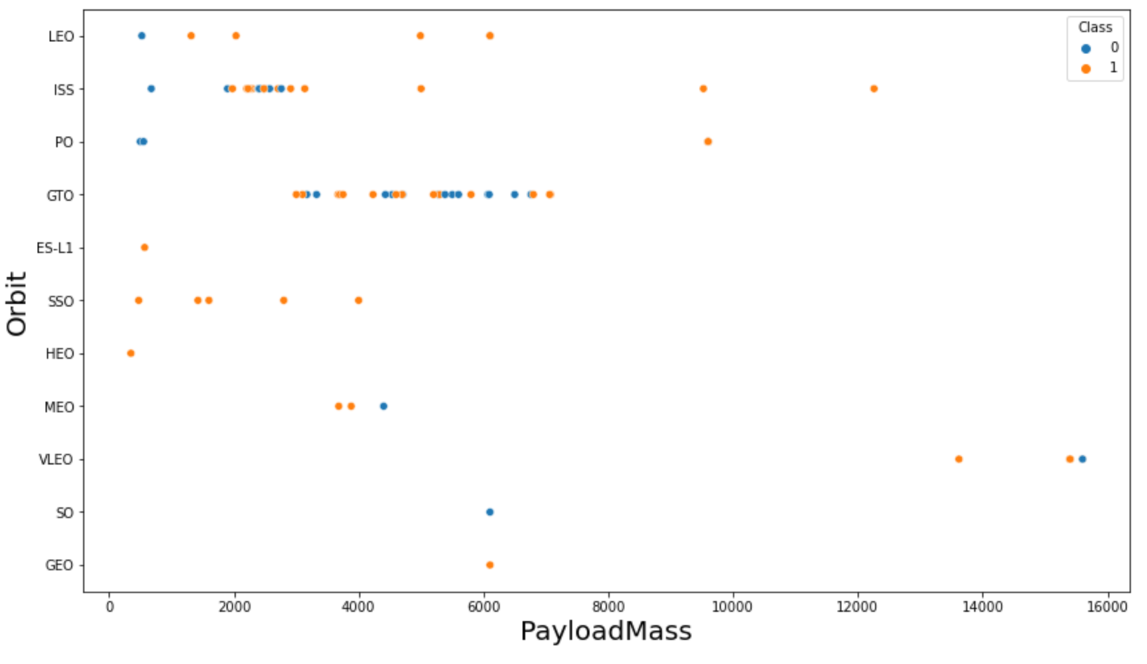
RESULTS
Matplotlib and Seaborn (EDA with Visualization)
The interplay between the mass of payloads and the types of orbits they are sent into.

Slide 23
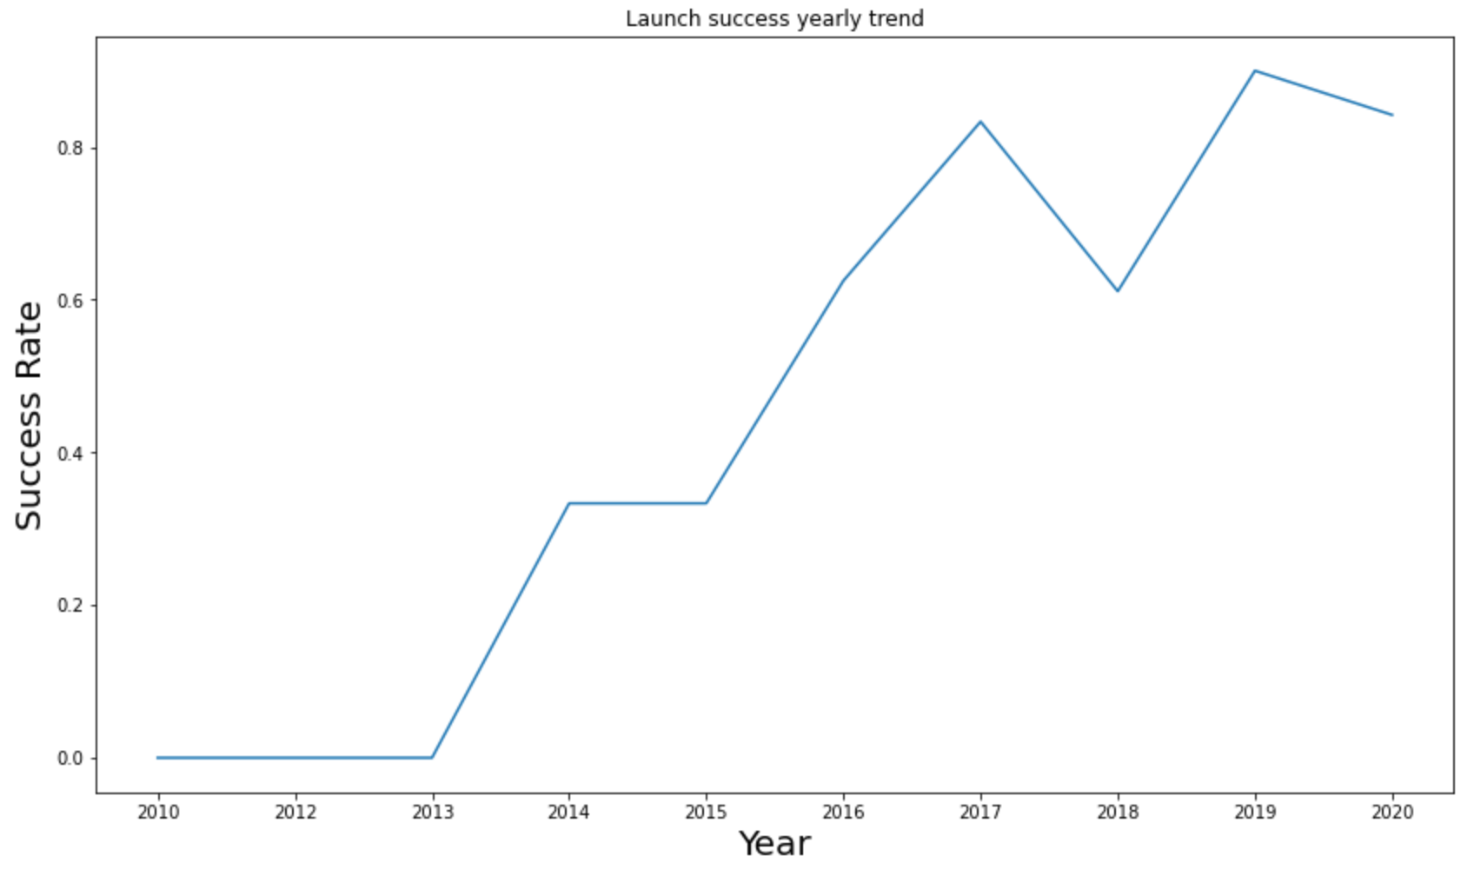
RESULTS
Matplotlib and Seaborn (EDA with Visualization)
The annual pattern of launch successes over time.

Slide 24
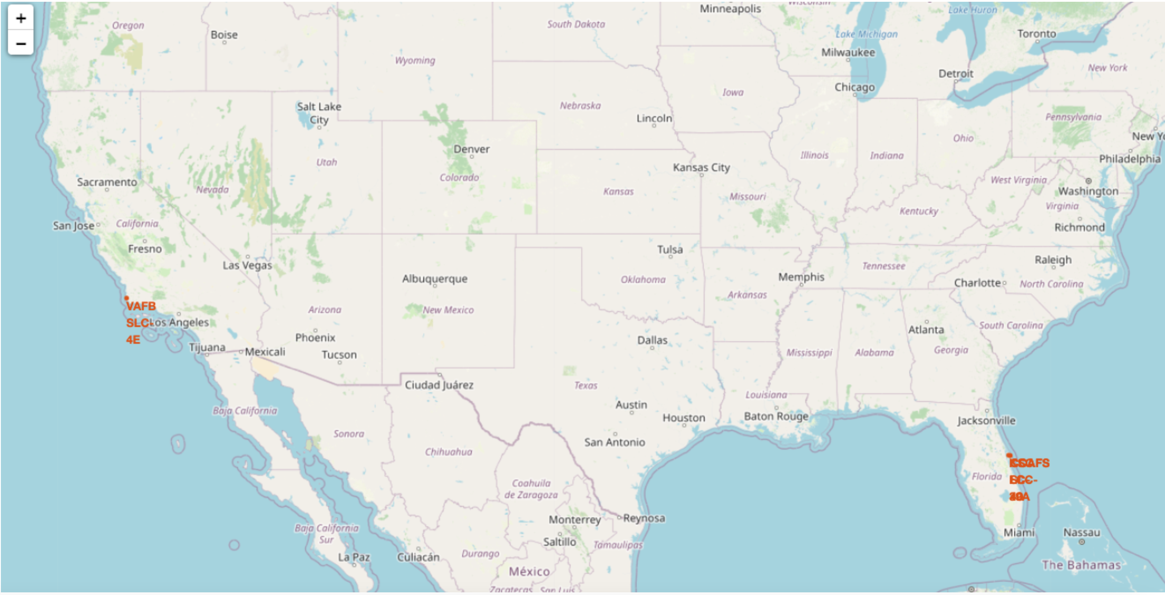
RESULTS
Folium
The geographical representation of all launch locations.

Slide 25
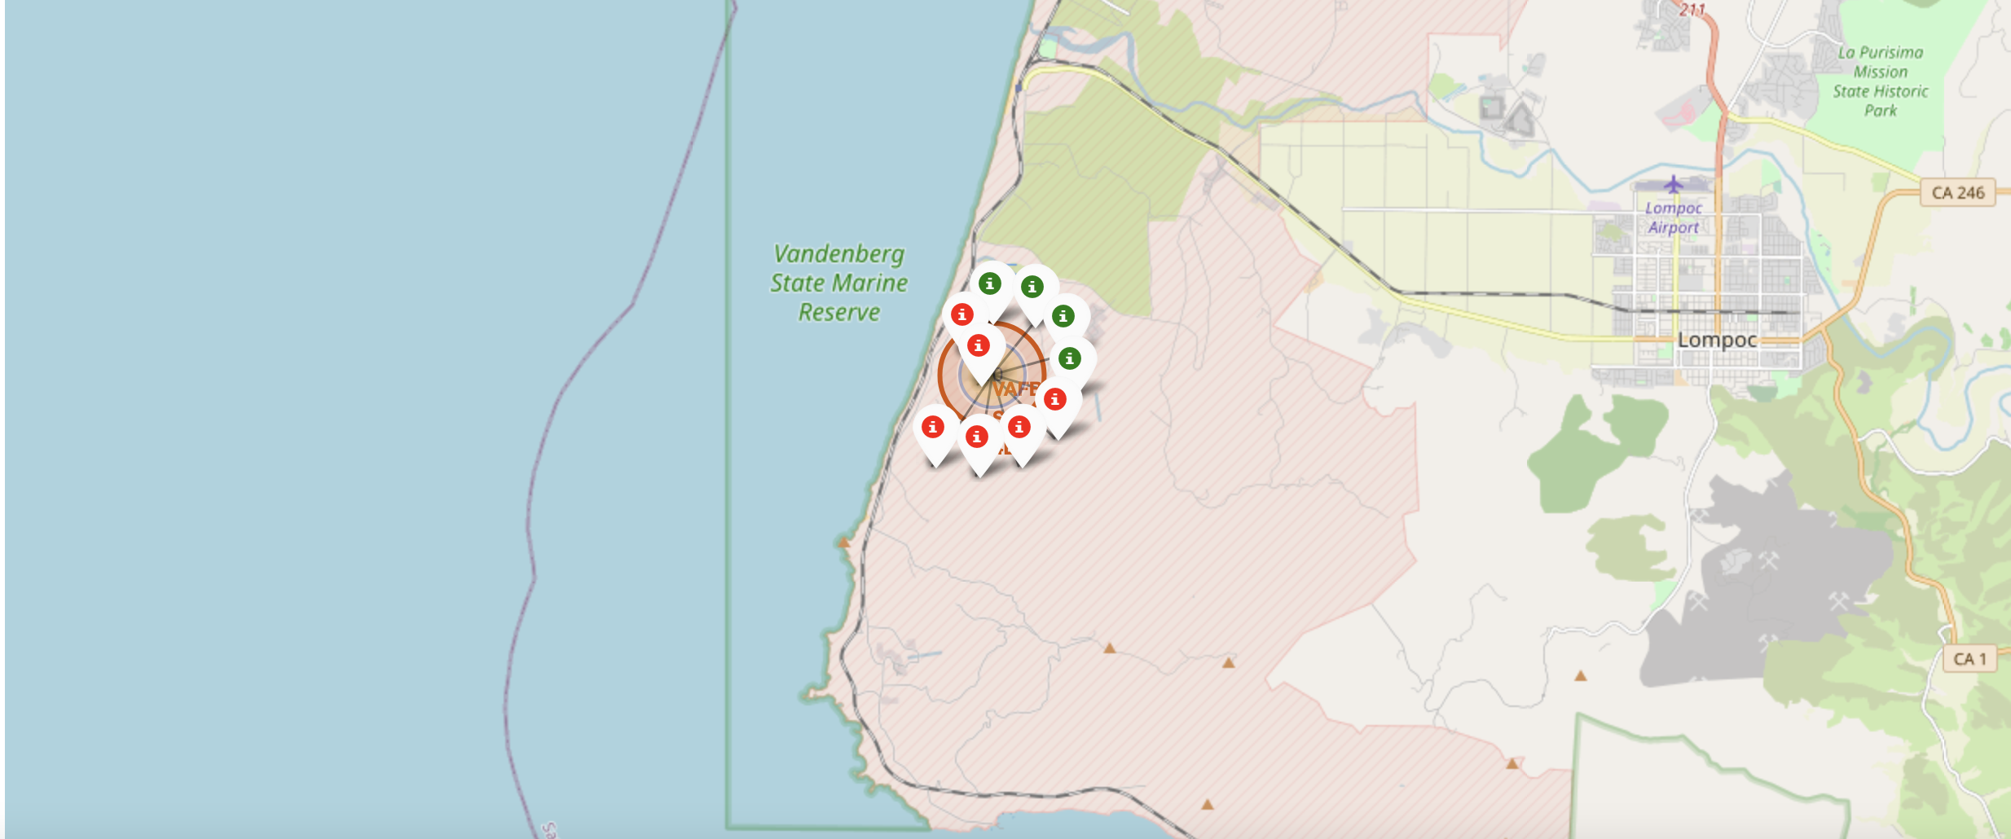
RESULTS
Folium
On the map displaying each launch site, successful and unsuccessful launches are marked with green and red pins respectively, with green indicating a launch success and red indicating a failure.

Slide 26
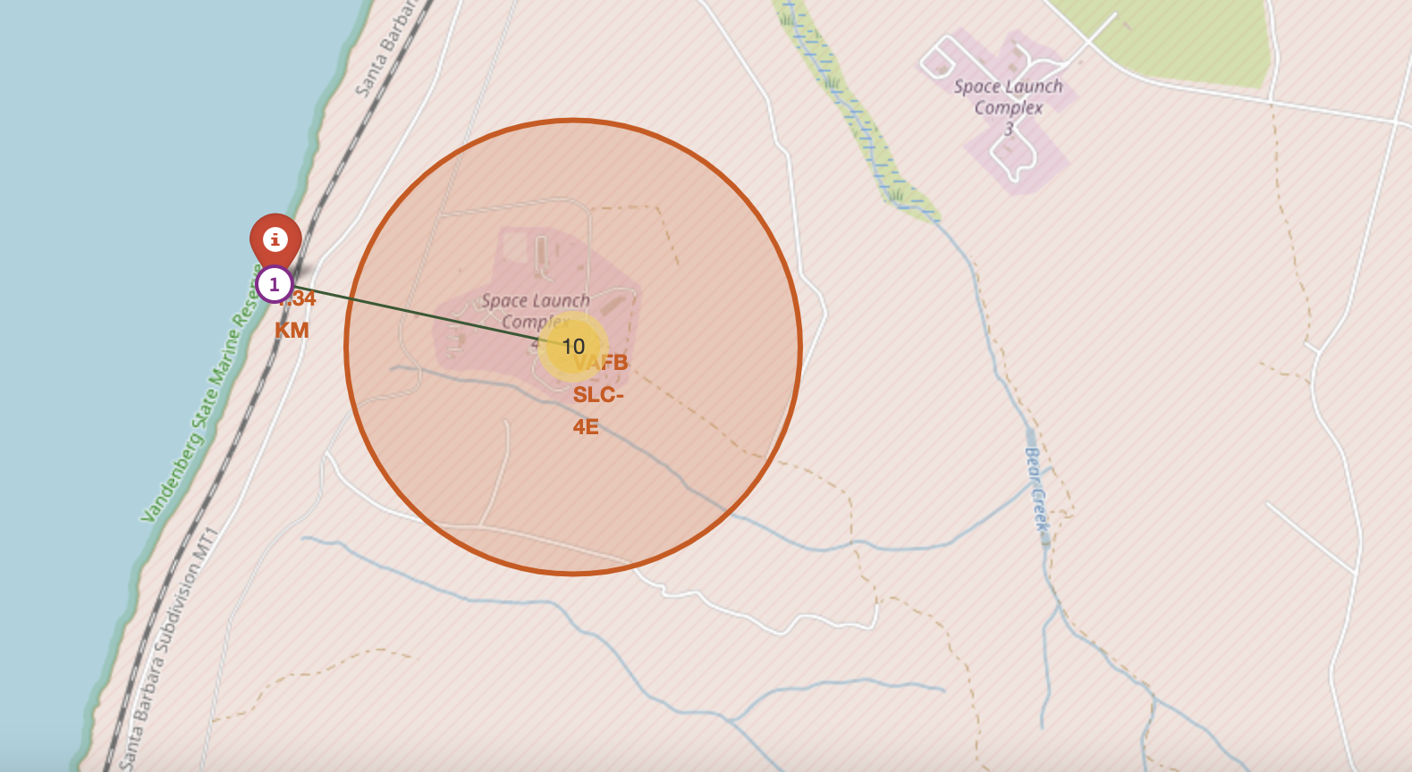
RESULTS
Folium
The visualization displays the distances from the VAFB SLC-4E launch site to nearby important infrastructure like cities, railways, and highways, highlighting the closest coastline.

Slide 27
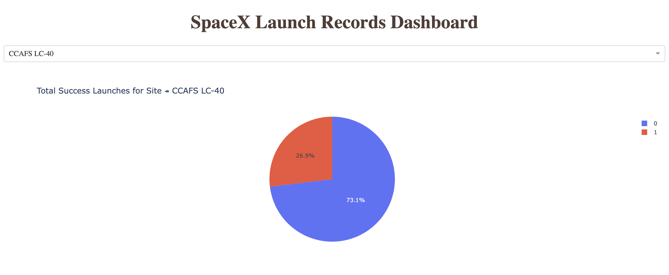
RESULTS
Dash
The displayed pie chart corresponds to the CCAFS LC-40 launch site, indicating that 73.1% of launches at this site did not achieve a successful landing.

Slide 28
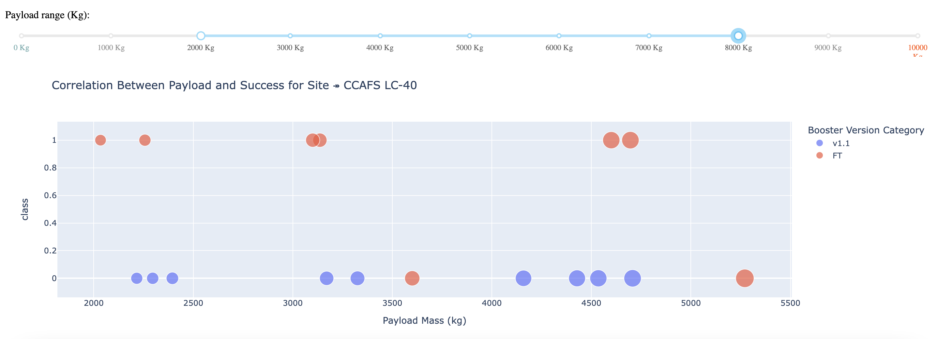
RESULTS
Dash
The image provided displays a scatterplot with the payload mass range from 2000kg to 8000kg. In this visualization, class 0 is indicative of launch failures and class 1 of launch successes.

Slide 29
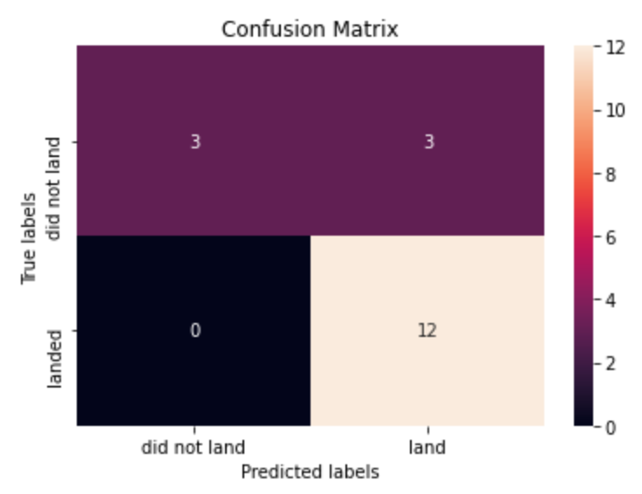
RESULTS
Predictive Analysis
For logistic regression, the optimal score achieved through GridSearchCV is approximately 0.846, while the accuracy on the test set is about 0.833. The confusion matrix visualizes the true positive and false positive rates, indicating 12 correct predictions for landings, 3 incorrect non-landing predictions, and no false positives for landings.

Slide 30
RESULTS
Predictive Analysis
The Support Vector Machine model has achieved a top score of approximately 0.848 via GridSearchCV, with an accuracy of about 0.833 on the test dataset. The confusion matrix indicates 12 successful landing predictions and 3 misclassified as unsuccessful landings, with no instances of false positives for successful landings.

Slide 31
RESULTS
Predictive Analysis
The Decision Tree model has achieved a GridSearchCV best score of approximately 0.8892857142857142, with the model's accuracy on the test data being about 0.8333333333333334.
The associated confusion matrix shows that there were 12 correct predictions for landing and 3 incorrect predictions for non-landing, with zero false positives for landing.

Slide 32
RESULTS
Predictive Analysis
The K Nearest Neighbors (KNN) model has secured the highest GridSearchCV score of approximately 0.8482142857142858 and achieved an accuracy of about 0.8333333333333334 on the test set.
The confusion matrix demonstrates 12 accurate predictions for successful landings and 3 misclassified predictions for non-landings, with no successful landings incorrectly predicted as failures.

Slide 33
RESULTS
Predictive Analysis
Upon comparative evaluation, the four machine learning models demonstrate identical accuracy and confusion matrix outcomes on the test set. They are ranked by their respective GridSearchCV best scores as follows:
Decision tree with a score of 0.8892857142857142
K nearest neighbors (KNN) with a score of 0.8482142857142858
Support vector machine (SVM) with a score of 0.8482142857142856
Logistic regression with a score of 0.8464285714285713

Slide 34
DISCUSSION
The visual data analysis suggests certain features may influence the outcome of the mission in various ways. For instance, heavier payloads appear to correlate with a higher success rate in orbits such as Polar, LEO, and ISS. However, with GTO orbits, it is less clear-cut as both successful and unsuccessful landings are observed.
As a result, it is understood that each feature can impact the mission result to some extent. While it is challenging to determine precisely how these features affect the outcome, machine learning algorithms can be applied to discern patterns from historical data to forecast the likelihood of mission success based on the available features.

Slide 35
CONCLUSION
The objective of this project is to forecast whether the initial stage of a Falcon 9 rocket will successfully land, thus assisting in cost estimation for each launch. Various aspects of a Falcon 9 launch, including payload weight and orbital trajectory, potentially influence mission results.
A suite of machine learning techniques has been applied to historical launch data to construct models capable of predicting Falcon 9 launch outcomes. Of the four machine learning models tested, the decision tree model emerged as the most effective.

